Slide 1
Naive Bayes
Tim Pengajaran
Mata Kuliah Machine Learning
Jurusan Teknologi Informasi Tahun 2021

Slide 2
Disclaimer
This presentation material, including examples, images, references are provided for informational and explanation assistance only
The names of actual products and companies mentioned here in, if any, may be the trademarks of their respective owners
Credits shall be given to the images taken from the open-source and cannot be used for promotional activities

Slide 3
Outline Naive Bayes
Bayes’ Theorem
Generative and Discriminative Models
Naive Bayes Computation

Slide 4
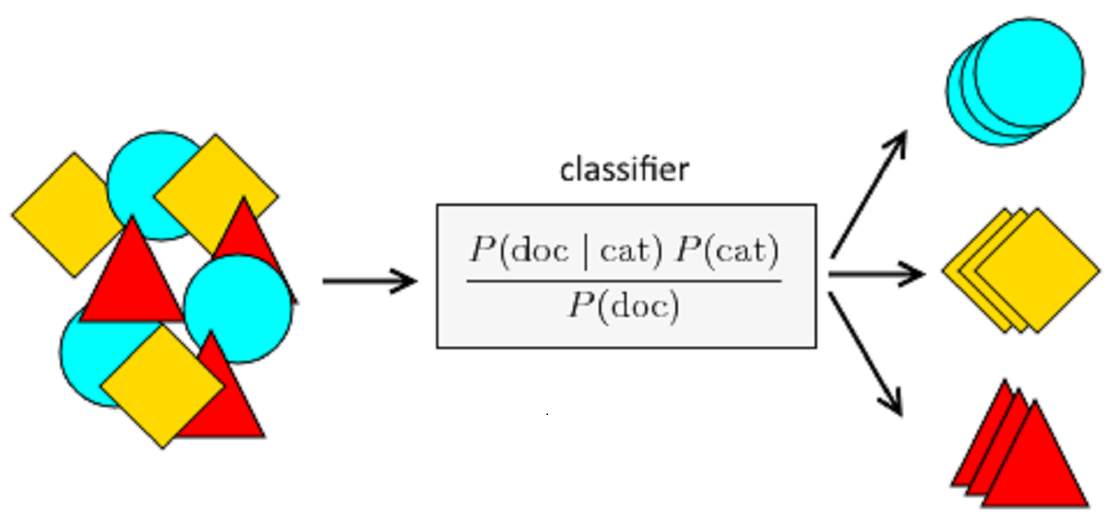
Recalling Classifier
A machine learning model that is used to discriminate different objects based on certain features.
Naive Bayes Classifier.

Slide 5
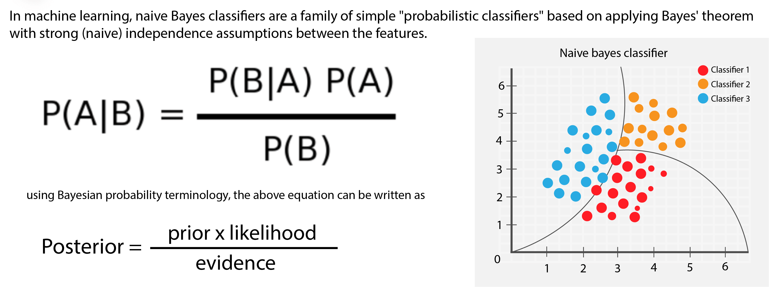
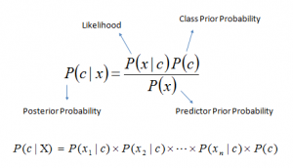
What is Naive Bayes?
A probabilistic machine learning model that’s used for classification task.
Its essential is based on the Bayes theorem.

Slide 6
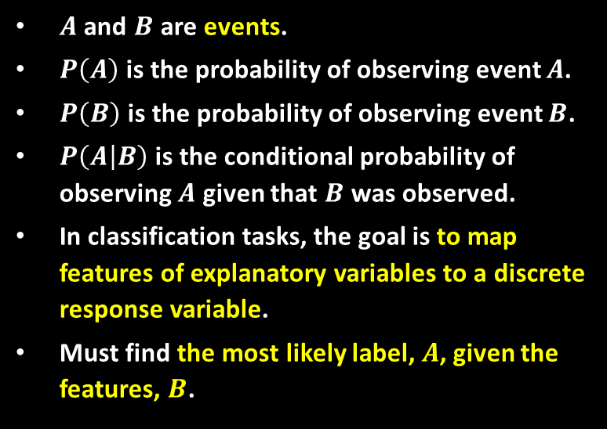
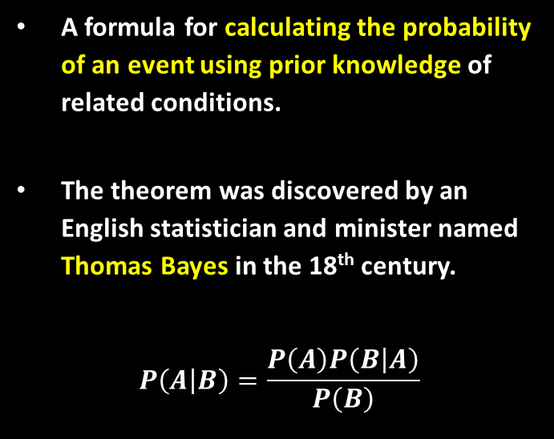
Bayes’ Theorem
A formula for calculating the probability of an event using prior knowledge of related conditions.
The theorem was discovered by an English statistician and minister named Thomas Bayes in the 18th century.
$$P\left(A | B\right)=\frac{P\left(A\right)P\left(B | A\right)}{P\left(B\right)}$$
$A$ and $B$ are events.
$P\left(A\right)$ is the probability of observing event $A$.
$P\left(B\right)$ is the probability of observing event $B$.
$P\left(A | B\right)$ is the conditional probability of observing $A$ given that $B$ was observed.
In classification tasks, the goal is to map features of explanatory variables to a discrete response variable.
Must find the most likely label, $A$, given the features, $B$.

Slide 7
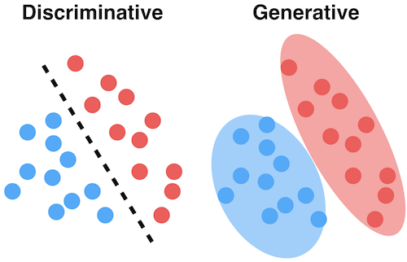
Discriminative and Generative Model
Discriminative models learns a decision boundary that is used to discriminate between classes.
Generative models model the joint probability distribution of the features and the classes, P(x, y).

Slide 8
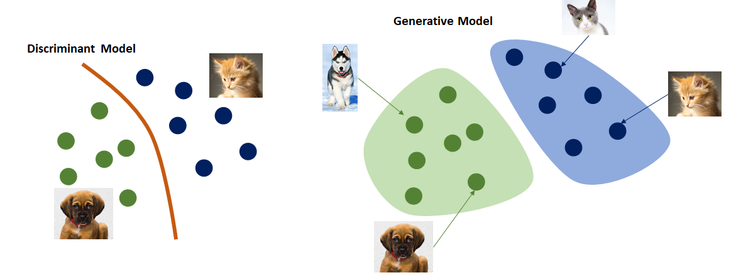
Discriminative vs. Generative Model

Slide 9
Generative Model
Equivalent to modelling the probabilities of the classes and the probabilities of the features given the classes.
Models model how the classes generate features or new examples of the data with intermediate steps but can be more biased.
More robust to noisy training data and may perform better when training data is scarce.
Intermediate step introduces more assumptions to the model. When these assumptions. The disadvantage is that these assumptions can prevent generative models from learning

Slide 10
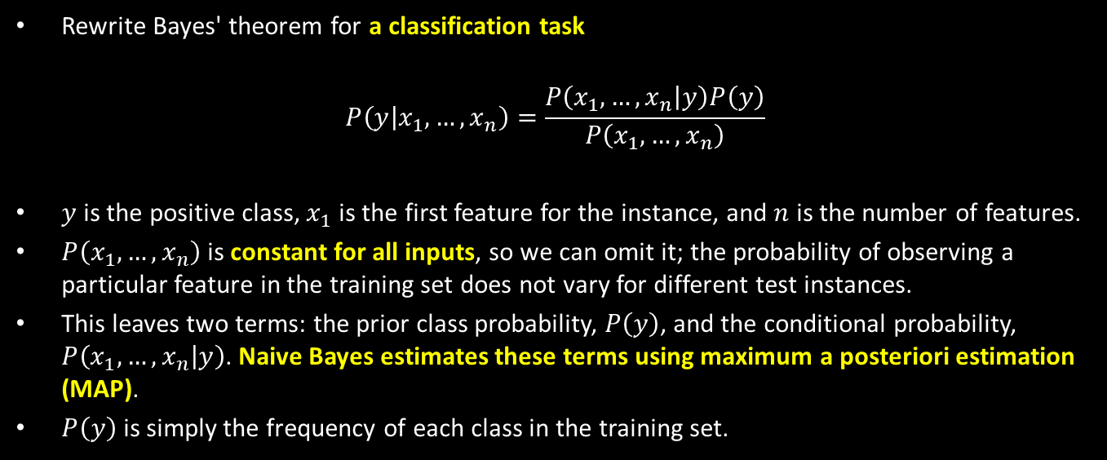
Naive Bayes Computation
Rewrite Bayes' theorem for a classification task
$$P\left(y | x_{1},…,x_{n}\right)=\frac{P\left(x_{1},…,x_{n} | y\right)P\left(y\right)}{P\left(x_{1},…,x_{n}\right)}$$
$y$ is the positive class, $x_{1}$ is the first feature for the instance, and $n$ is the number of features.
$P\left(x_{1},…,x_{n}\right)$ is constant for all inputs, so we can omit it; the probability of observing a particular feature in the training set does not vary for different test instances.
This leaves two terms: the prior class probability, $P\left(y\right)$, and the conditional probability, $P\left(x_{1},…,x_{n} | y\right)$. Naive Bayes estimates these terms using maximum a posteriori estimation (MAP).
$P\left(y\right)$ is simply the frequency of each class in the training set.

Slide 11
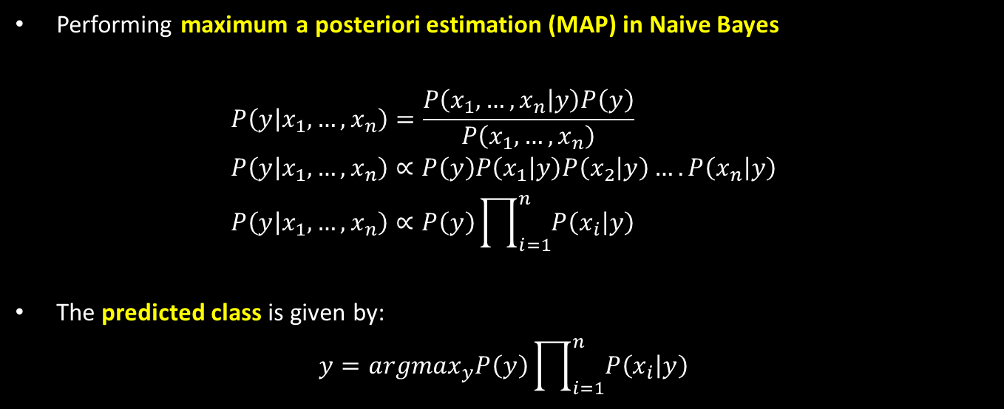
Naive Bayes Computation
Performing maximum a posteriori estimation (MAP) in Naive Bayes
$$P\left(y | x_{1},…,x_{n}\right)=\frac{P\left(x_{1},…,x_{n} | y\right)P\left(y\right)}{P\left(x_{1},…,x_{n}\right)} \\ P\left(y | x_{1},…,x_{n}\right)∝P\left(y\right)P\left(x_{1} | y\right)P\left(x_{2} | y\right)….P\left(x_{n} | y\right) \\ P\left(y | x_{1},…,x_{n}\right)∝P\left(y\right)\prod_{i=1}^{n}{P\left(x_{i} | y\right)}$$
The predicted class is given by:
$$y={argmax}_{y}P\left(y\right)\prod_{i=1}^{n}{P\left(x_{i} | y\right)}$$

Slide 12
Assumptions of NB
The features are conditionally independent given the response variable.
Training instances are independent and identically distributed (i.i.d), this means that training instances are independent from each other and are drawn from the same probability distribution.

Slide 13
Naive Bayes Types
Multinomial Naive Bayes – Mostly used for document classification problem, i.e whether a document belongs to the category of sports, politics, technology etc. The features/predictors used by the classifier are the frequency of the words present in the document.
Bernoulli Naive Bayes – Similar to the multinomial one but the predictors are Boolean variables. The parameters that is used to predict the class variable take up only values yes or no, for example if a word occurs in the text or not.
Gaussian Naive Bayes – When the predictors take up a continuous value and are not discrete, assumed that these values are sampled from a Gaussian distribution.

Slide 14

Let’s Watch a Film

Slide 15
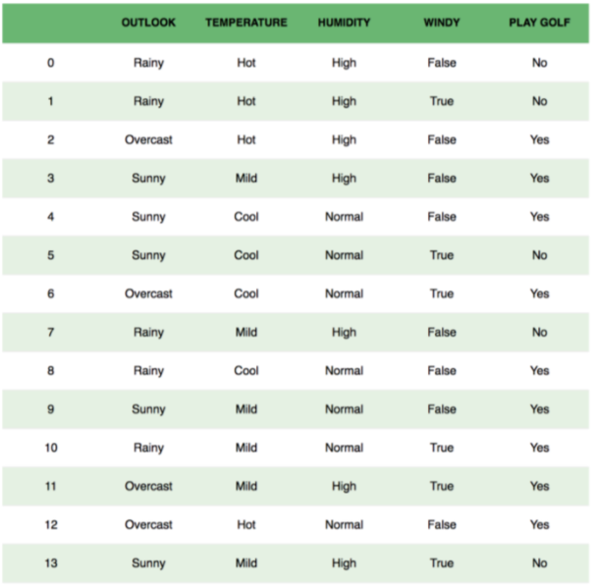
Exercise
Classify whether the day is suitable for playing golf, given the features of the day.
The columns represent these features and the rows represent individual entries.
Example: If we take the first row of the dataset, we can observe that is not suitable for playing golf if the outlook is rainy, temperature is hot, humidity is high and it is not windy.
How to predict “Play Golf or Not knowing Information given by the Features”?

Slide 16
Homework
Create Python codes to make prediction to the Case on the Left.
Write the Manual Computation in Spreadsheet application to compare the results with the Automatic Compution in point 1.

Slide 17
Thank You for Today
Always Keep Your Spirit!

